Slide 1



Data Analysis on Customer Churn for Banking Services
- Abhinav Mishra

Slide 2

About the Project
My Team
Chesapeake Annual Hackathon at UMBC sponsored by M&T Bank 2023
8 hours, 24 Teams
Topic: Predictive Analytics for Customer Retention in Banking
Winner – 1st Prize

Slide 3






Work flow

Slide 4
About the Dataset
RowNumber: This is the index for each record in the dataset CustomerId: A unique identifier for each customer. Surname: The last name of the customer. CreditScore: The credit score of the customer, which is a numerical measure of their creditworthiness. Geography: The country or region where the customer is located (e.g., France, Spain, Germany). Gender: The gender of the customer (e.g., Male or Female). Age: The age of the customer. Tenure: The number of years the customer has been with the bank. Balance: The account balance of the customer. NumOfProducts: The number of bank products the customer is using (e.g., savings accounts, loans, etc.). HasCrCard: Whether the customer has a credit card (1 for yes, 0 for no). IsActiveMember: Whether the customer is an active member (1 for yes, 0 for no). EstimatedSalary: The estimated annual salary of the customer. Exited: It indicates whether the customer has churned or not (1 for churned, 0 for not churned).

Slide 5
Executive Summary
France has the highest number of bank customers, followed by Germany and Spain. However, the churn rate is highest in Germany (32.44%), followed by Spain (16.67%) and France (16.15%).
Female customers have a higher churn rate, contributing to 55.92% of total churn, compared to male customers who contribute 44.08%
The 41-50 age group has the highest churn (30.51%), followed by the 31-40 (20.84%) and 51-60 (17.35%) groups.
Churn rates are higher for customers with a credit card (69.89%) compared to those without (30.11%)
Most customers with lower credit scores (501-600: 25.21%, 601-700: 36.99%) have higher churn, while churn decreases significantly for scores above 700, indicating better retention among high credit score customers.
Customers with balances in the 100,001-250,000 range have the highest churn (59.94%), while churn decreases significantly for balances below 100,000 and above 250,000, suggesting a middle-range balance may be linked to higher churn risk.
Churn is significantly higher among customers with only 1 product (70.62%), while it decreases as the number of products increases, suggesting higher product engagement reduces churn risk.
Churn is significantly higher among inactive members (63.92%) compared to active members (36.08%), indicating that customer activity strongly influences retention.
Churn is highest during the first year of tenure (12.68%), gradually stabilizing over time, with minor fluctuations, indicating that retaining new customers is critical for reducing churn.

Slide 6
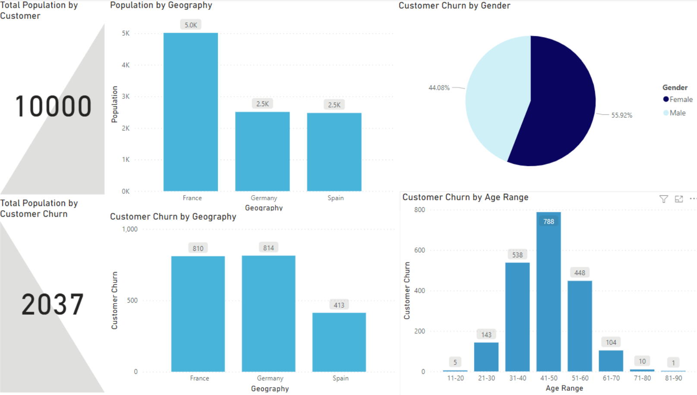
Demographic Churn Analysis

Slide 7
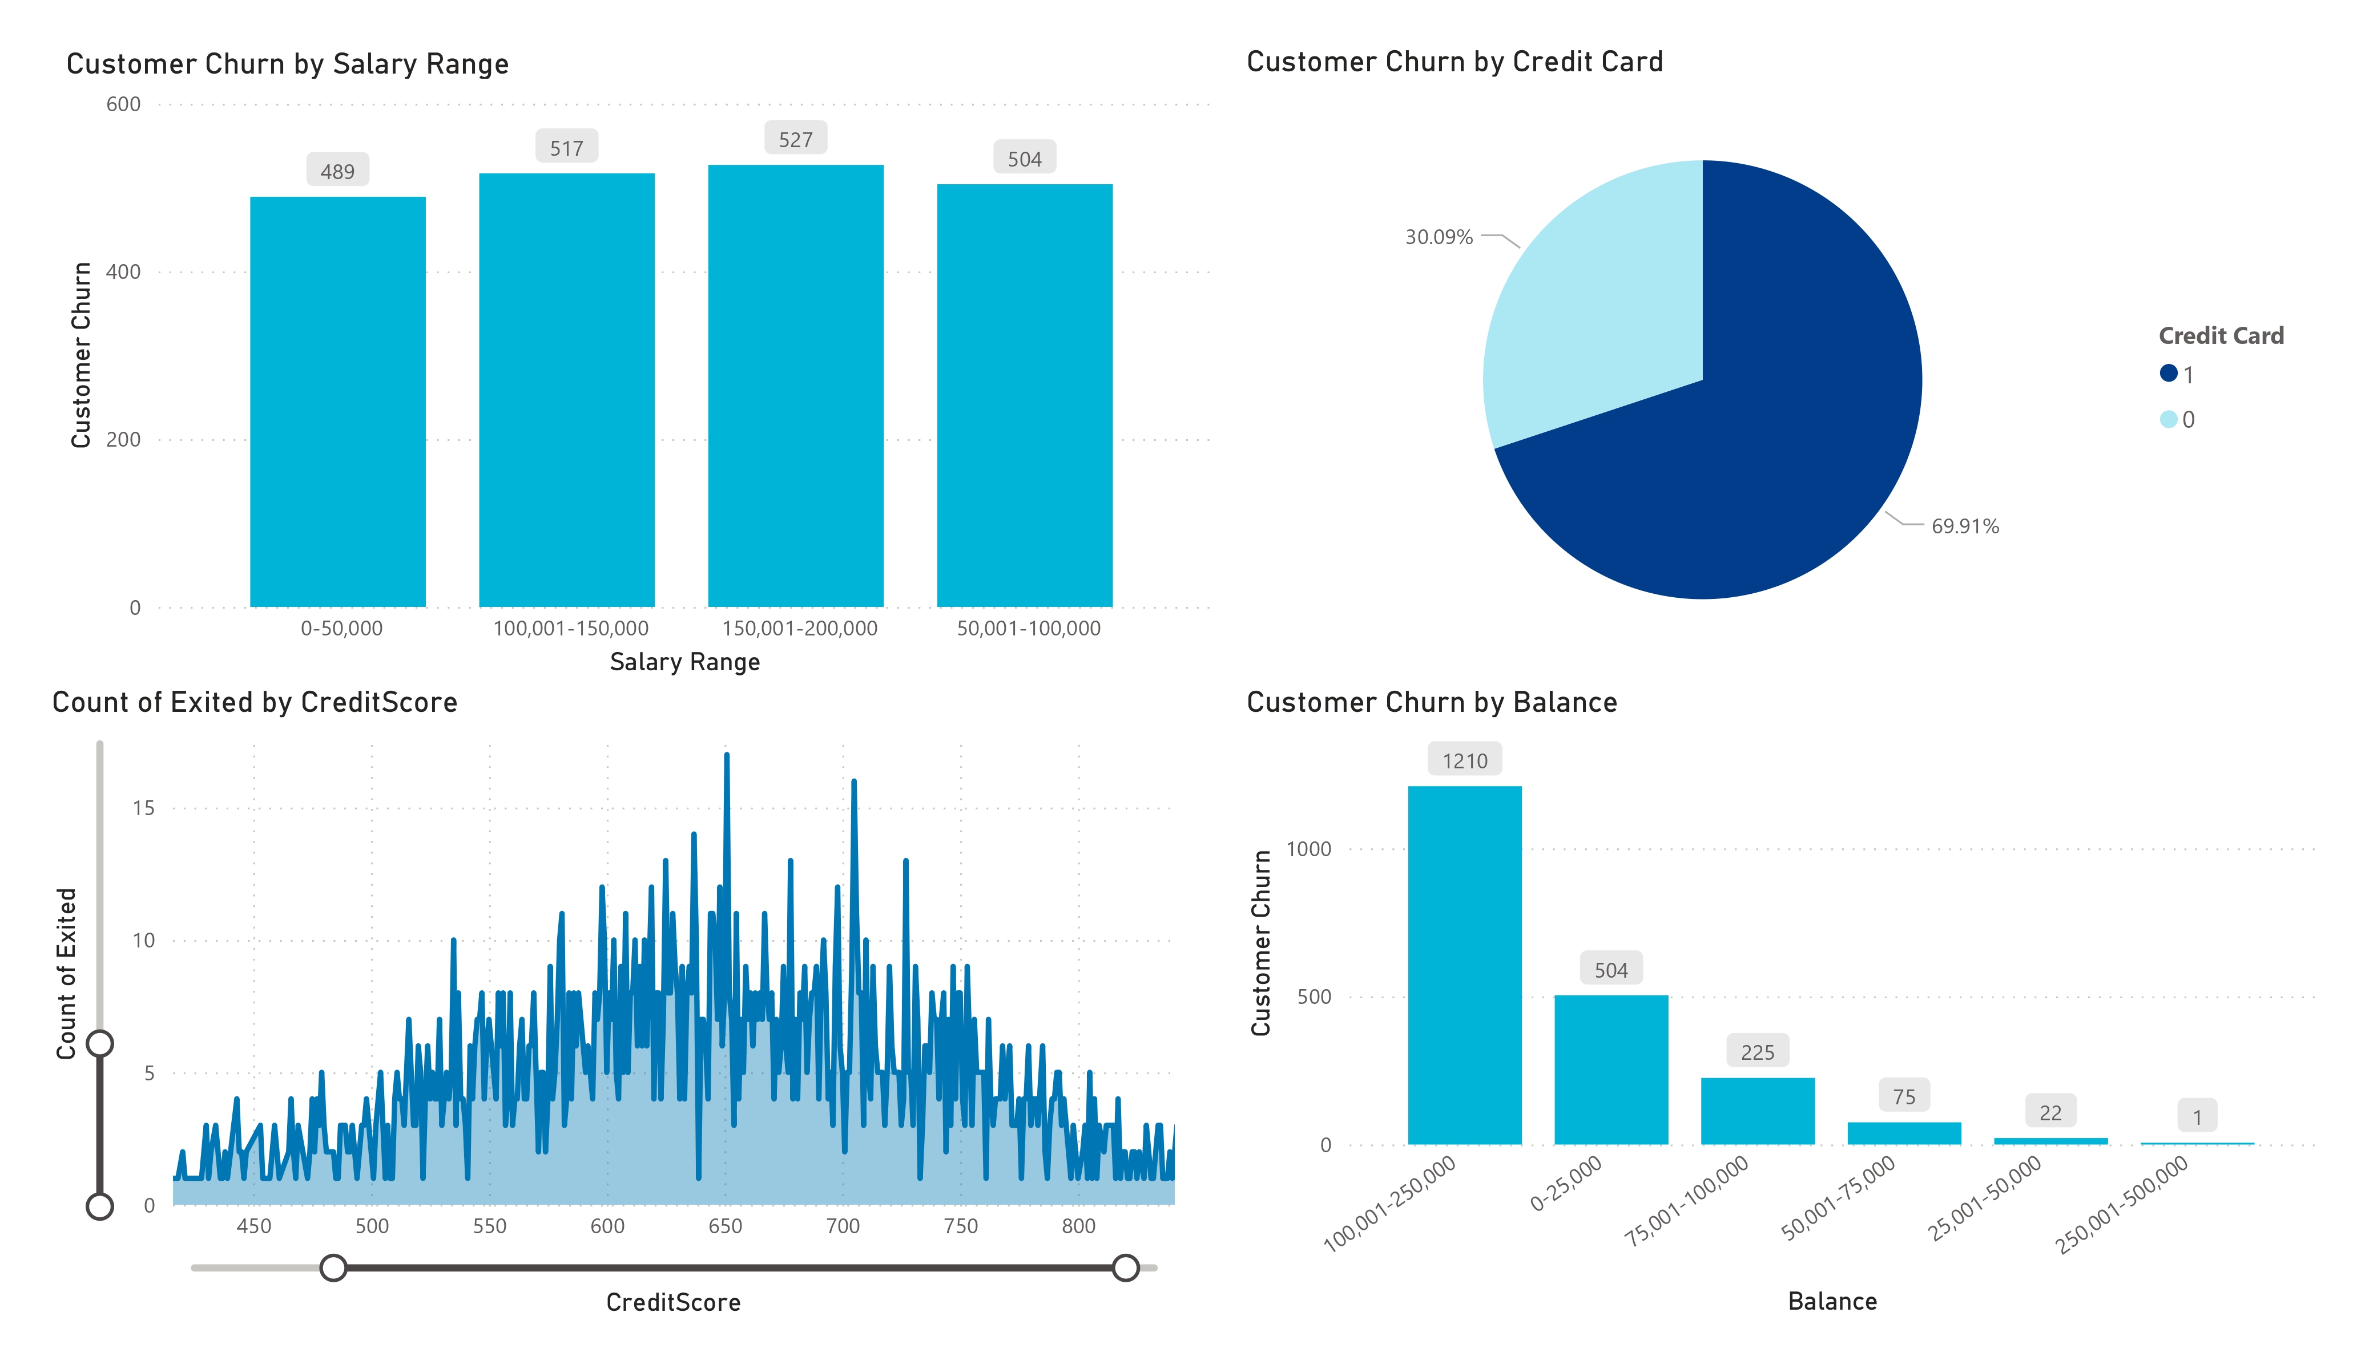
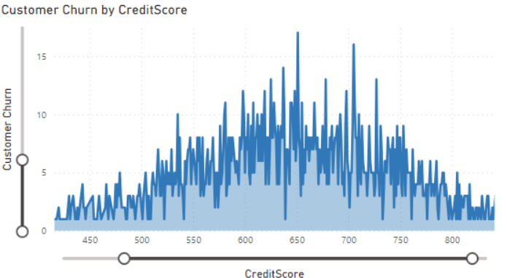
Financial Metrics

Slide 8
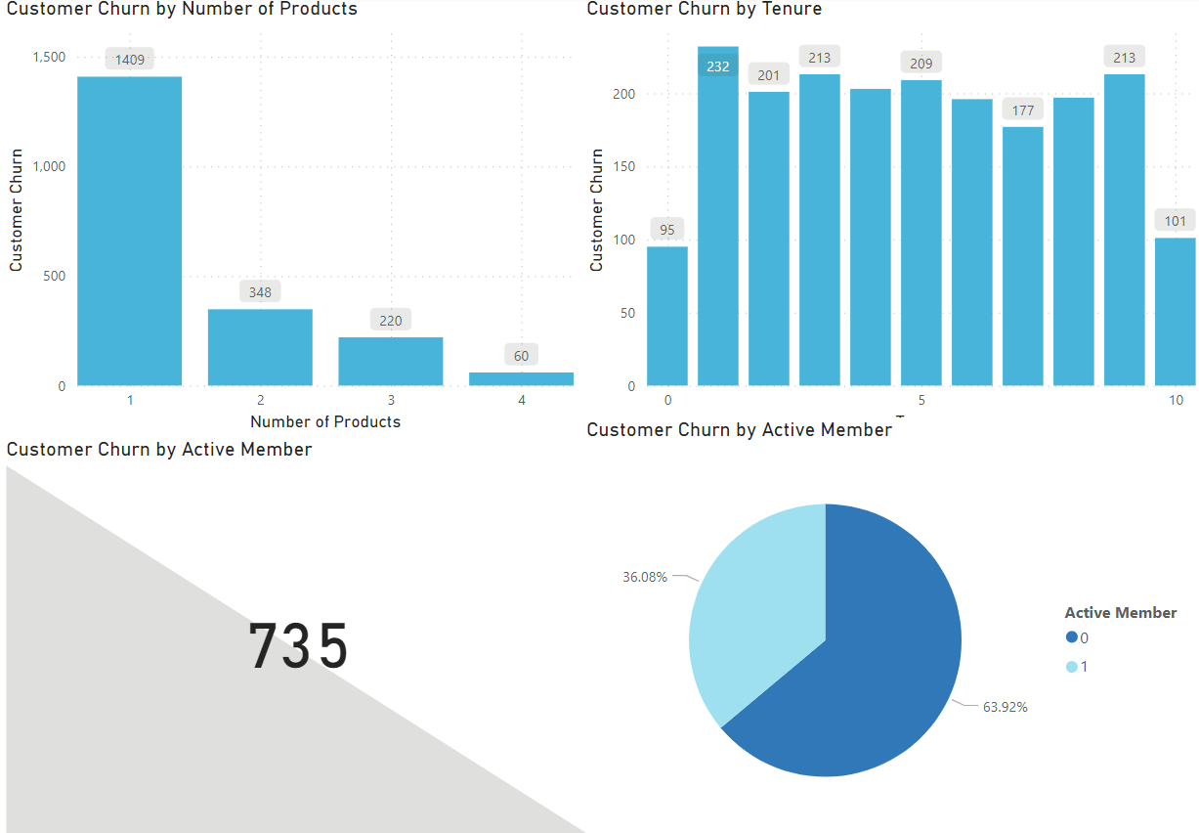
Impacts of Tenure/Active Member

Slide 9
Conclusion
In conclusion, our project demonstrated the power of data analytics in identifying key factors influencing customer churn in the banking sector. By leveraging tools like Power BI and AWS services, we delivered actionable insights to help banks improve customer retention. The findings emphasized the importance of understanding customer behavior and engagement to reduce churn rates. Winning first prize validates the effectiveness of our approach and highlights the potential of data-driven decision-making in the banking industry.

Slide 10

Thank You

